Slide 1

NI controller
Team Emergence,
Julian Blank, Frederick Sander

Slide 2
Overview
Evolutionary Algorithm
Sliding Window
Pessimistic Iteration
Adaptive Pathlength
Heuristic and Reward
Heuristic Switch
Gamedetection

Slide 3
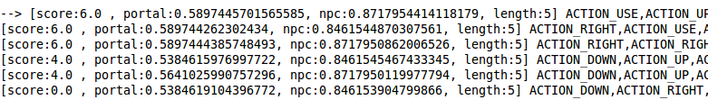
Evolutionary Algorithm
Initial pool with a list of just random actions → path
Crossover: For 50% action of the first and for 50% the action of the second
Mutation: Crossover with a random path
Example:

Slide 4
Sliding Window
Sliding Window
Pessimistic Iteration
Do not throw away the population from the last game tick.
Delete the first action and add one to the end.
Reset the generation counter and remove the score of all pathes.
Check always the next action n times
If the agent dies → search for another path by selecting the next best of the pool with another first action → do it again until the agent stays alive or the time is over

Slide 5
Adaptive Pathlength
Problem: Advance method has no static time duration
An Evolutionary Algorithm makes no sense if we stay always in the first generation
Adapt the path length of each entry of the pool to complete always the fourth generation → this is combined with the sliding window approach.

Slide 6
Heuristic and Reward
Different ways to evaluate a path:
  1. Reward
    Depends on gamescore and win/lose
  2. Heurstic Value
    Is generated for every state in the path
    Different Targets:
      NPC
      2x Portal
      ect...
Compare two paths:
  When Reward == 0 → use the heuristic value

Slide 7
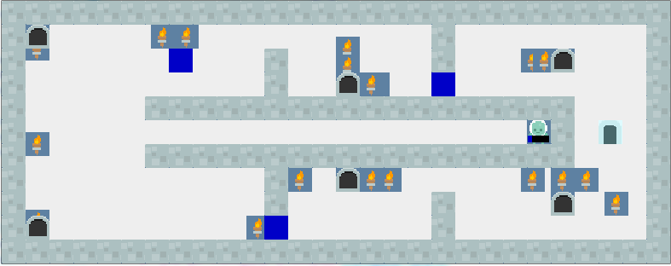
Heuristic Switch
Sometimes one game needs different heuristics
approaches:
  switch heuristic after a defined number of timesteps
  switch heuristic randomly

Slide 8
Gamedetection
Detect the game which is played:
  generate String of Objects in the game (npc, portal,...) → store hash value
  Constructor: put known hash values in hash set
  at the beginning of every game → check which game is played
  set settings depending on the game (pathlength, heuristic, …)
Improved performance in the 20 known games
Did not decrease performance in the test set
  no game is detected → standardsettings

Slide 9
References
First
Second
….

